Slide 1
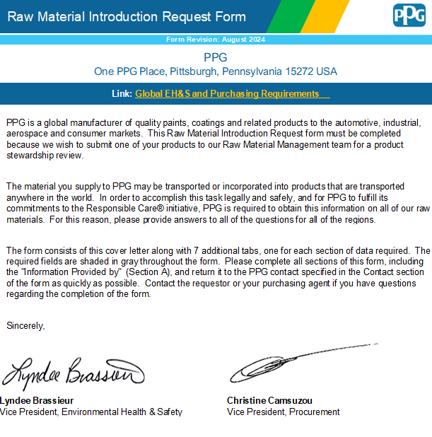
How to complete PPG’s Raw Material Information Request (RMIR) Form
How-to Training Guide for Suppliers

Slide 2
Outline
Click on the links below for quick access
Overview
Part A: Manufacturer, Distributor, and Contact Information
Part B: Product Information
Part C: Compositional Information
Part D: Regulatory Information
Part E: Attachments
Common Errors
Helpful Links

Slide 3



Overview – Getting to Know PPG
Back to Outline
PPG is a global company and maintains a long-standing tradition of developing leading-edge technologies, achieving the highest quality standards and meeting customers’ requirements. Through leadership in innovation, PPG helps customers in industrial, transportation, consumer products, and construction markets and aftermarkets to enhance more surfaces in more ways than does any other company.
Because of this global presence, the materials that will be provided to PPG may be transported or incorporated into products that are distributed anywhere in the world. To accomplish this task legally and safely, and for PPG to meet our sustainability initiatives and commitments to Responsible Care™, PPG requires information about all of your supplied raw materials and products.

Slide 4
Overview – The Raw Material Introduction Request (RMIR) Form
To approve a Supplier’s material for use, PPG requires suppliers to provide the following information related to their material:
PPG’s RMIR Form
Safety Data Sheet(s) (English language and local language where product will be used)
Certificate of Analysis
Technical Data Sheet, if available
This information will be reviewed by PPG, and any questions or inconsistent data will be returned to the supplier to correct or respond.
This is a critical process because this information becomes the foundation for PPG to use the product in formulations, and is the key driver for EHS proper use and handling, regulatory data, and PPG product hazard communication documentation.

Slide 5
Overview – The RMIR Tabs
PPG’s RMIR form has 7 tabs, 5 of which need to be completed prior to submission:
Introduction
  Introduction
  The first tab of the RMIR. A brief message from PPG’s Vice President of Environmental Health & Safety and PPG’s Vice President of Procurement. This tab does not need to be completed.
A
Contact Info
  Part A – Manufacturer, Distributor and Contact Information Slides 6-7
  General information about the manufacturer, distributor(s), and supplier contact details such as email addresses and phone numbers.
B
Product Info
  Part B – Product Information Slides 8-11
  An overview of the physical properties (including packaging, handling, and storage instructions) of the product being supplied to PPG.
C
Composition
  Part C – Compositional Information Slides 12-18
  A compositional breakdown of the product being supplied to PPG.
PPG Declarable Substances
  PPG Declarable Substances List Slide 19
  A list of CAS numbers which must be included in Part C if they are present in the product at any level.
D
Regulatory Info
  Part D – Regulatory Information Slides 20-24
  Data about the product related to regional or country-specific chemical inventories, and other specific regulations such as food contact and biocides.
E
Attachments
  Part E – Attachments Slide 25
  An optional place for a supplier to attach or insert the required supplemental documentation on their product.

Slide 6
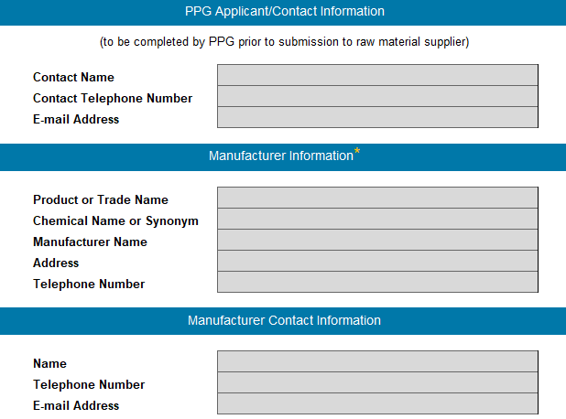
Part A – Manufacturer, Distributor and Contact Information
Back to Outline
General information about the manufacturer, distributor(s), and supplier contact details such as email addresses and phone numbers.
PPG Applicant/Contact Information will be completed by PPG. The questionnaire should be returned to the email address provided.
Manufacturer Information is required. Product name and manufacturer name must match all documentation provided with the questionnaire.
Manufacturer Contact Information is essential for PPG to follow up if there are questions regarding the questionnaire.

Slide 7
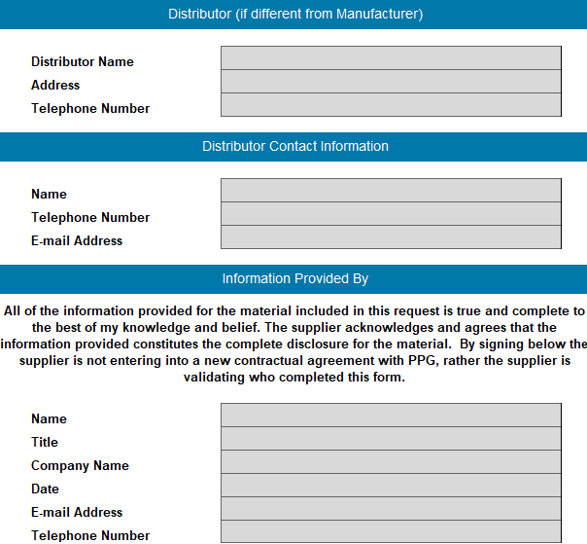
Part A – Manufacturer, Distributor and Contact Information
Back to Outline
Distributor Information is optional. If distributor documentation is provided with the questionnaire or the distributor is completing the form, it is recommended.
Information Provided By identifies the individual completing the form and serves to provide acknowledgement of the full disclosure of material information.

Slide 8
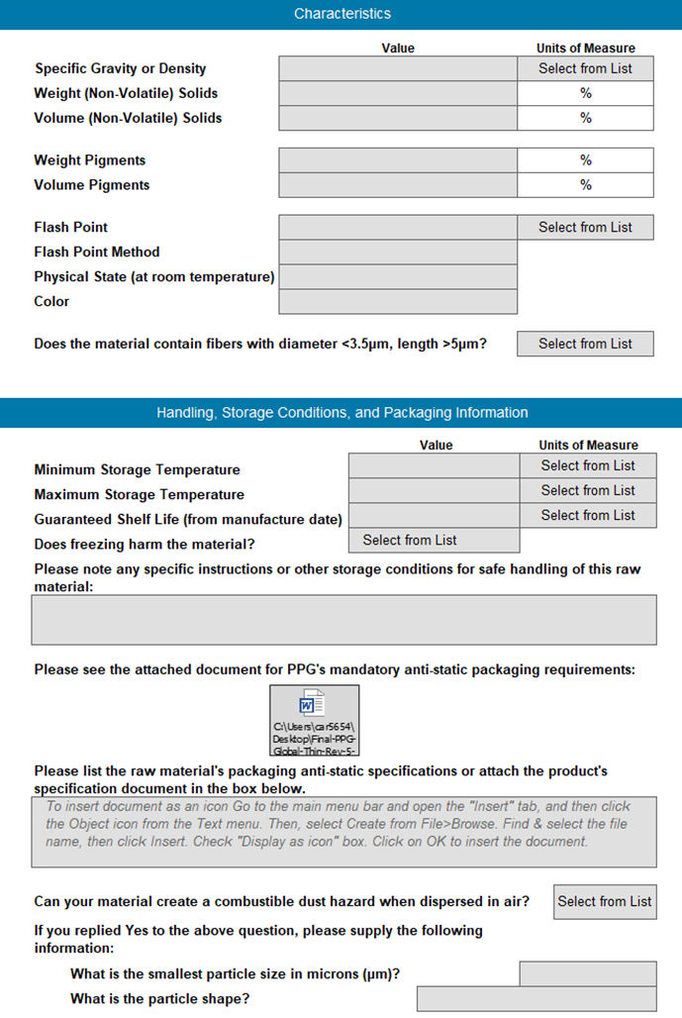
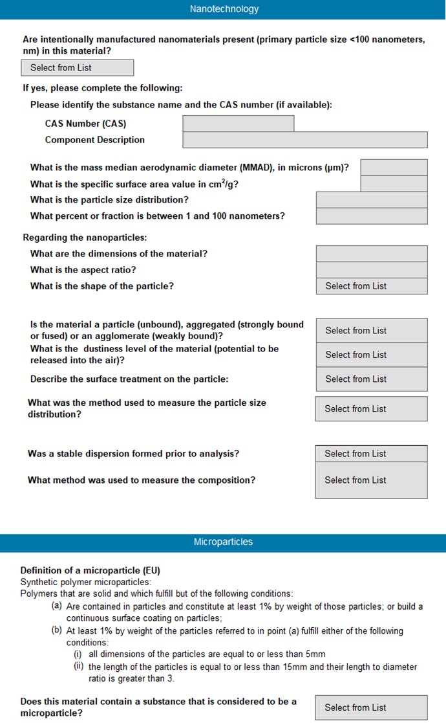
Part B – Product Information
Back to Outline
An overview of the physical properties (including packaging, handling, and storage instructions) of the product being supplied to PPG.
Accuracy of physical properties for a material is essential to ensure the health and safety of PPG employee’s and customers.
  Characteristics
  Handling & Storage
  Nanotechnology
  Microparticles

Slide 9
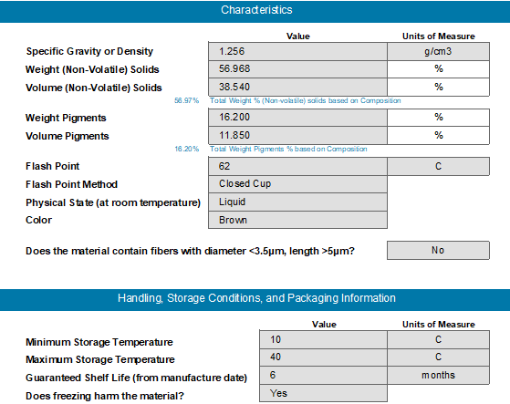

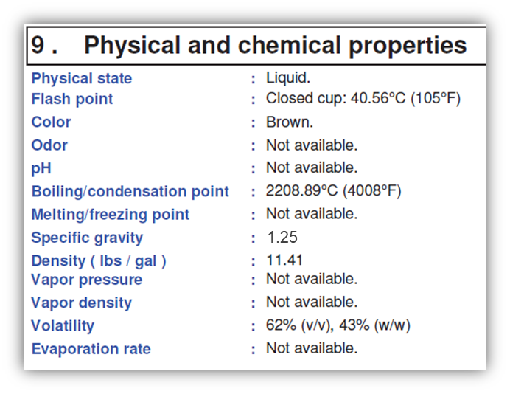

Part B – Product Information
Back to Outline
An overview of the physical properties (including packaging, handling, and storage instructions) of the product being supplied to PPG.
Product information must be consistent across all provided documents.

Slide 10
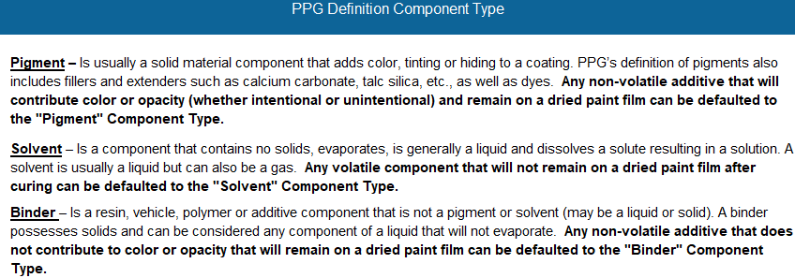
Part B – Product Information
Back to Outline
An overview of the physical properties (including packaging, handling, and storage instructions) of the product being supplied to PPG.
Note that these will populate and automatically total based on the information that was input in Part C: Composition
A guide of PPG’s definitions for component type can be found on Tab C.
Use these definitions to guide the data entry for solids and pigments.

Slide 11
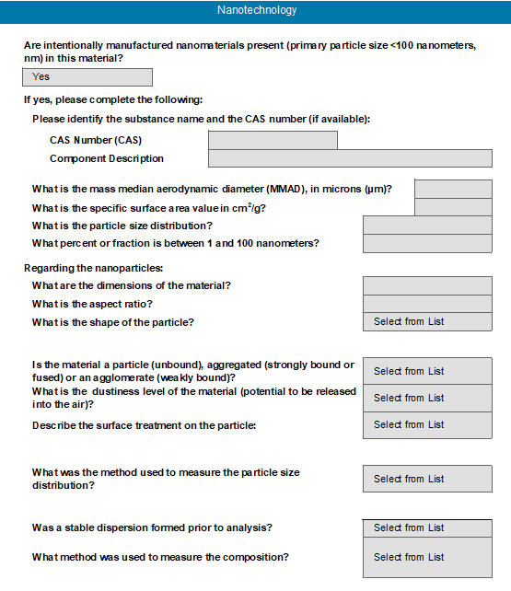
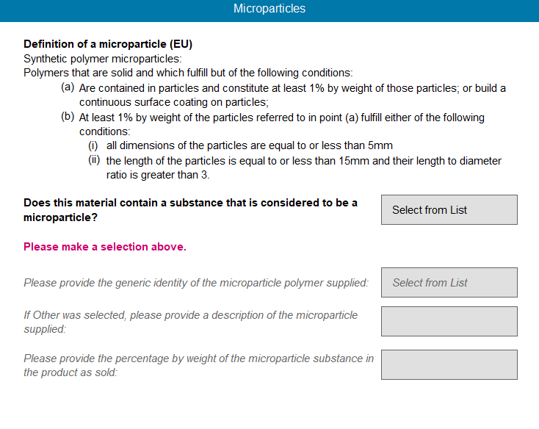
Part B – Product Information
Back to Outline
An overview of the physical properties (including packaging, handling, and storage instructions) of the product being supplied to PPG.
Nanotechnology and microparticle information must be provided if applicable to the product.
The additional questions should be answered as thoroughly and completely as possible.

Slide 12
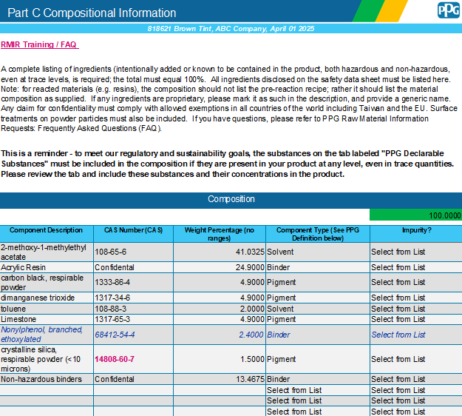
Part C – Compositional Information
Back to Outline
A compositional breakdown of the product being supplied to PPG.
PPG requires disclosure of all the hazardous and non-hazardous components of the product to evaluate the potential risk
The composition must total 100%
Substances may be kept proprietary with a general description of the substance

Slide 13
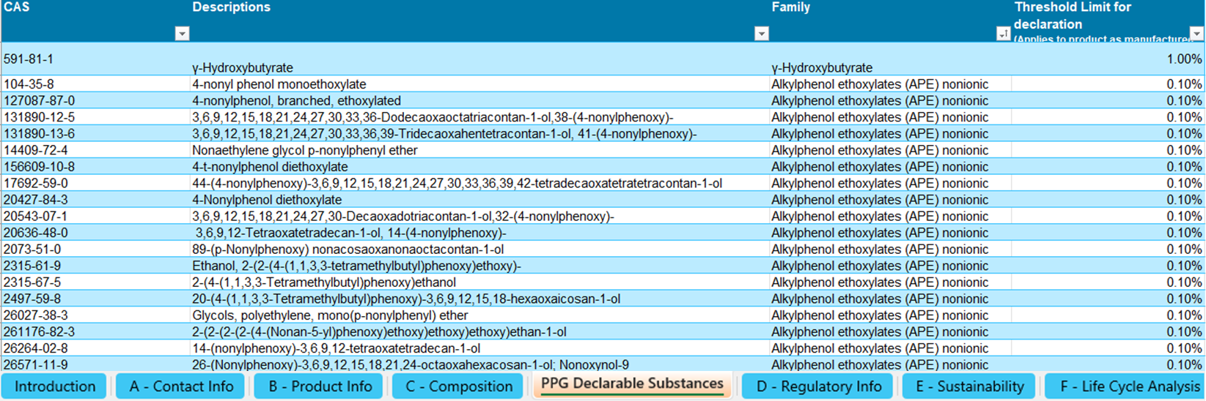
Part C – Compositional Information
Back to Outline
A compositional breakdown of the product being supplied to PPG.
The RMIR contains a list of PPG Declarable Substances. These substances must be included in the composition section of the RMIR form if they are present in the product, even in trace quantities.

Slide 14
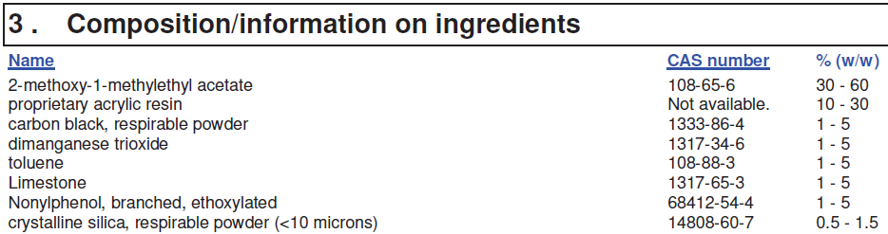
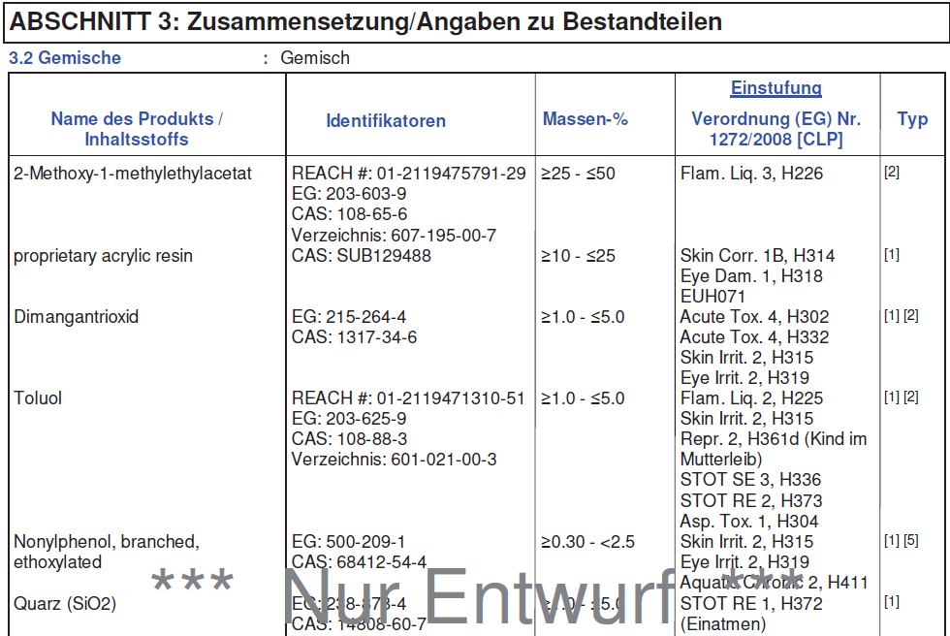
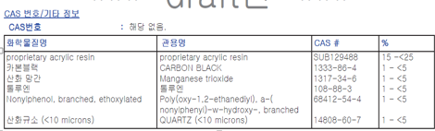
Part C – Compositional Information
Back to Outline
A compositional breakdown of the product being supplied to PPG.
All ingredients disclosed on the SDSs must be reported on the RMIR.
This includes components reported in the Regulatory Information section of the SDS, even if at trace levels.

Slide 15
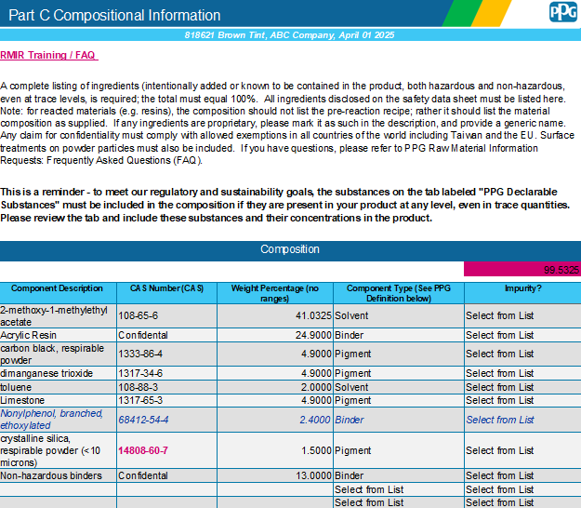
Part C – Compositional Information
Back to Outline
A compositional breakdown of the product being supplied to PPG.
The form will calculate the total percentage and flag if it does not equal 100%.
Substances may be kept confidential if a general description for the substance is provided
Weight percentage must be provided as a single value. Ranges are not accepted.

Slide 16
Part C – Compositional Information
Back to Outline
A compositional breakdown of the product being supplied to PPG.
Double clicking the row line below an entry will auto-fit a long description.

Slide 17
Part C – Compositional Information
Back to Outline
A compositional breakdown of the product being supplied to PPG.
Some substances may flag for additional information, as shown in the example below.
This information can be provided in the Component Description field or in the following row.
See next slide for other special cases

Slide 18
Part C – Compositional Information
Back to Outline
A compositional breakdown of the product being supplied to PPG.
Special Case Substances
RMIR Message | Why does PPG Ask? | Example CAS | Example Answer
Please state the degree of polymerization for this CAS number. | Hazard classification differences based on degree of polymerization | 9046-10-0 | n>6
Please provide the molecular weight of this substance. | Hazard classification differences based on molecular weight | 25036-25-3 | MW>1100
Please state the average number of moles EO. | Hazard classification differences based on number of moles | 32492-61-8 | EO>4.5 moles
Please provide the respirable fraction (<10 microns) of this substance. | Hazard classification differences based on particle size | 14808-60-7 | 0.9% total, with 0.2% (<10 microns)
Please state if this CAS number contains greater than 5% of sulfuric acid. | Hazard classification differences based on sulfuric acid content | 104-15-4 | No
Please provide the EC number for this substance. | European REACH regulations and registrations | 64742-95-6 | EC 918-668-5
Please specify the substance form. | Hazard classification differences based on substance form in product | 409-21-2 | Non-fibrous

Slide 19
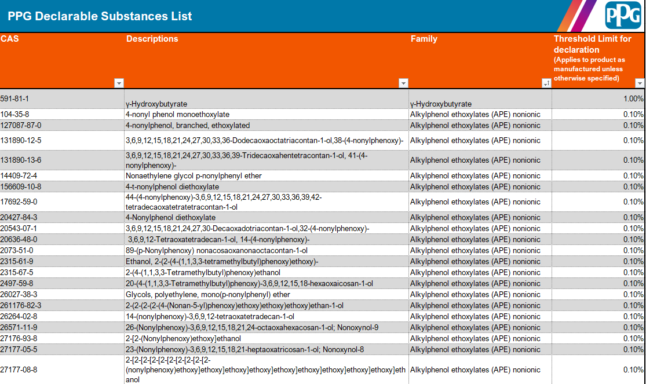
PPG Declarable Substances
Back to Outline
A list of CAS numbers which must be included in Part C if they are present in the product at any level.
To meet our regulatory and sustainability goals, these substances must be disclosed in the composition section if they are present in your product at any level, even in trace quantities.

Slide 20
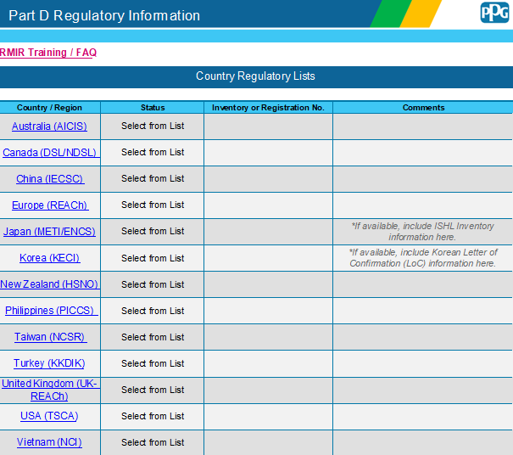
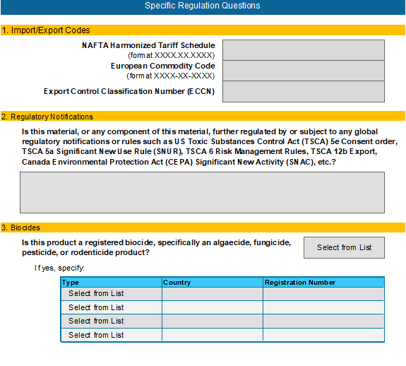
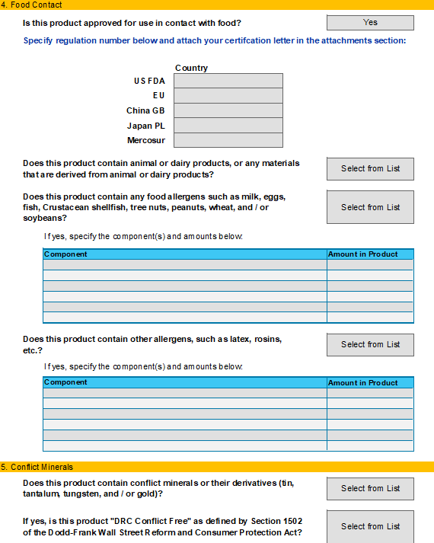
Part D – Regulatory Information
Back to Outline
Data about the product related to regional or country-specific chemical inventories, and other specific regulations such as food contact and biocides.
PPG is a global company and has an obligation to evaluate raw materials and products against several global regulatory requirements
The Regulatory Information tab requires disclosure of Chemical Inventory Status in 13 countries/regions, and will grow as more inventories are developed
The additional specific regulation questions should be answered as thoroughly and accurately as possible

Slide 21
Part D – Regulatory Information
Back to Outline
The status column includes a specific dropdown list of applicable status options for each country/region.
PPG requires the status for ALL requested locations.
Data about the product related to regional or country-specific chemical inventories, and other specific regulations such as food contact and biocides.
We expect product manufacturers to know the regulatory status of the products they market and sell
In some cases, the regulatory status will determine if PPG can use a product globally, or if its use is limited to a region, country, application, or not be used
The country/region column contains a link to the chemical inventory lookup site for that country/region.

Slide 22
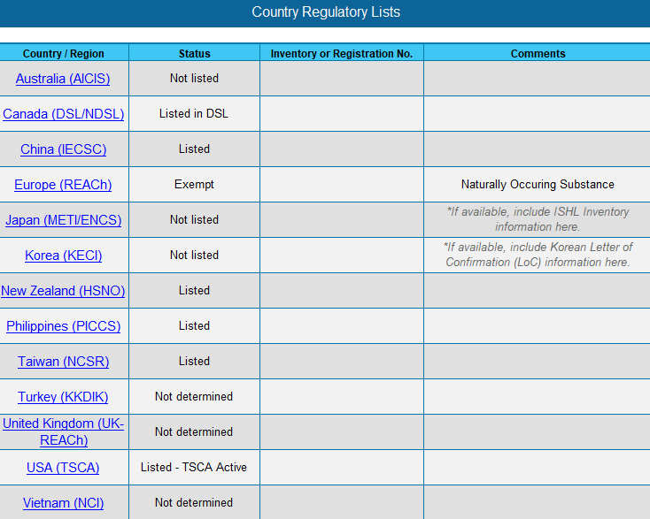
Part D – Regulatory Information
Back to Outline
Data about the product related to regional or country-specific chemical inventories, and other specific regulations such as food contact and biocides.
If any component is not listed for a specific country/region, the overall status should be “Not Listed”
If the status is Exempt, we require a comment to confirm the reason for the exemption.
If any country/region does not lead to a clear determination, use the “Not determined” status

Slide 23

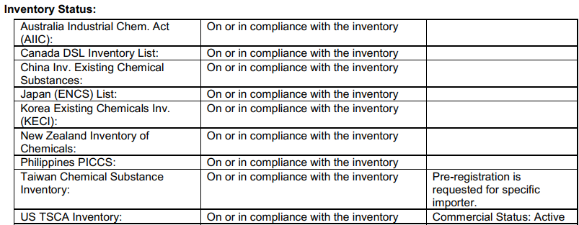
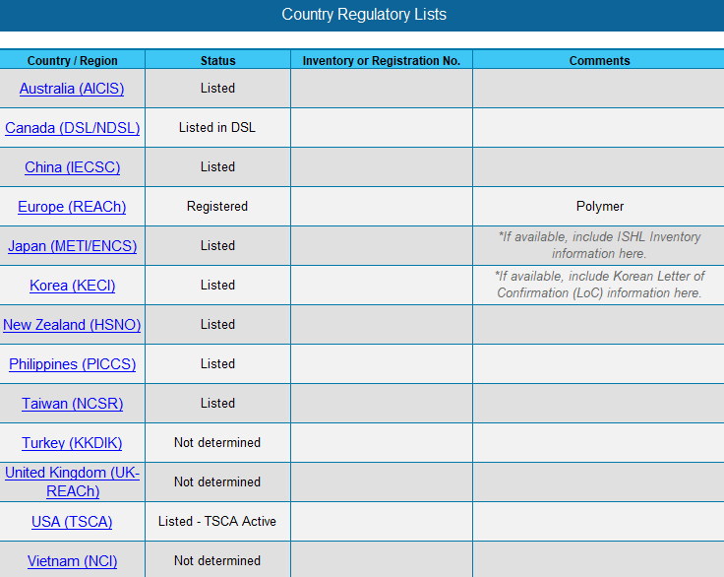
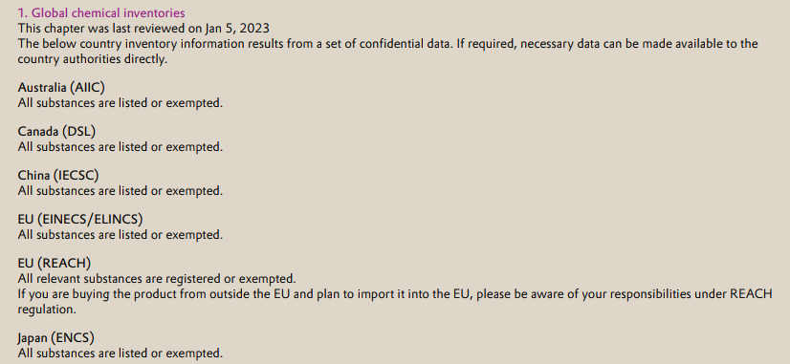
Part D – Regulatory Information
Back to Outline
Data about the product related to regional or country-specific chemical inventories, and other specific regulations such as food contact and biocides.
The statuses entered on the RMIR must agree with any supporting documents provided

Slide 24
Part D – Regulatory Information
Back to Outline
Data about the product related to regional or country-specific chemical inventories, and other specific regulations such as food contact and biocides.
Specific Regulation Questions should be answered as completely and thoroughly as possible
  Import/Export Codes
  Regulatory Notifications
  Biocides
  Food Contact
  Conflict Minerals
Some sections require additional information or attachments depending on the answers

Slide 25
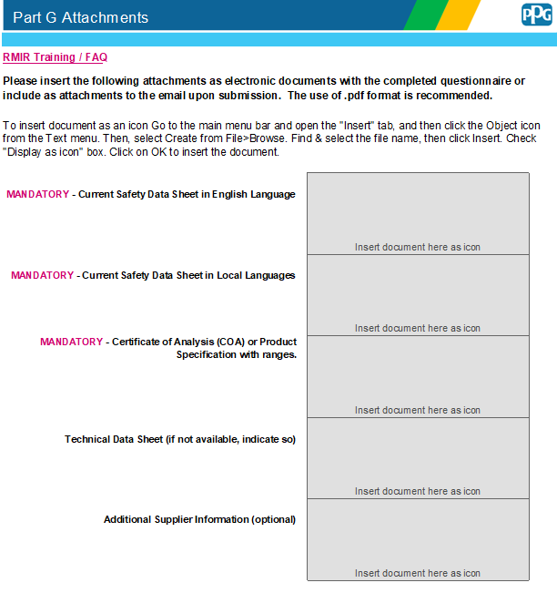
Part E – Attachments
Back to Outline
An optional place for a supplier to attach or insert the required supplemental documentation on their product.
Mandatory documents include:
Safety Data Sheet
Local language of intended use Safety Data Sheet
Certificate of Analysis (CoA)

Slide 26


Common Errors
Examples of common mistakes made on the RMIR with suggested corrections.

Slide 27
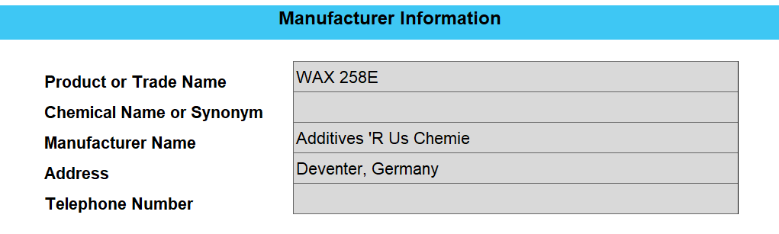
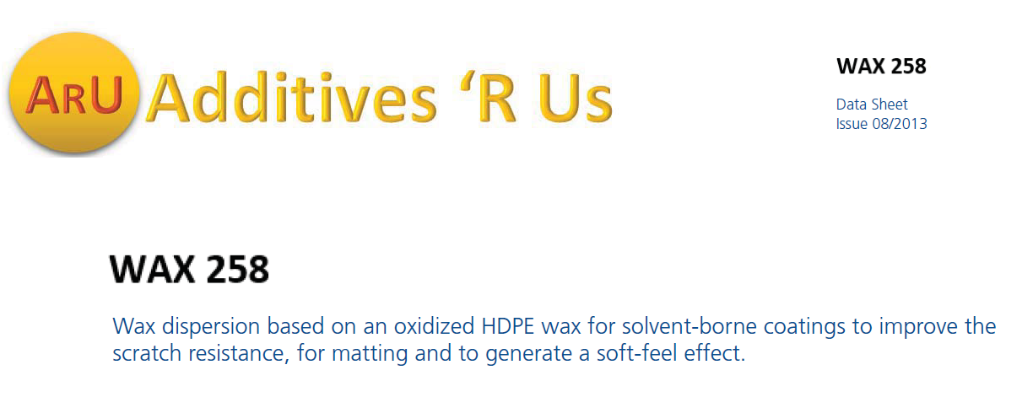
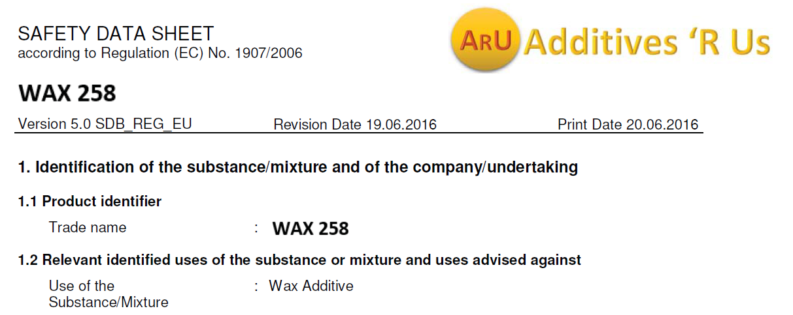
Common Errors
Back to Outline
Inconsistent material name across documents.
PPG will review all documents provided for consistency.
Even slight differences, such as one additional letter or number, will be questioned.
E

Slide 28
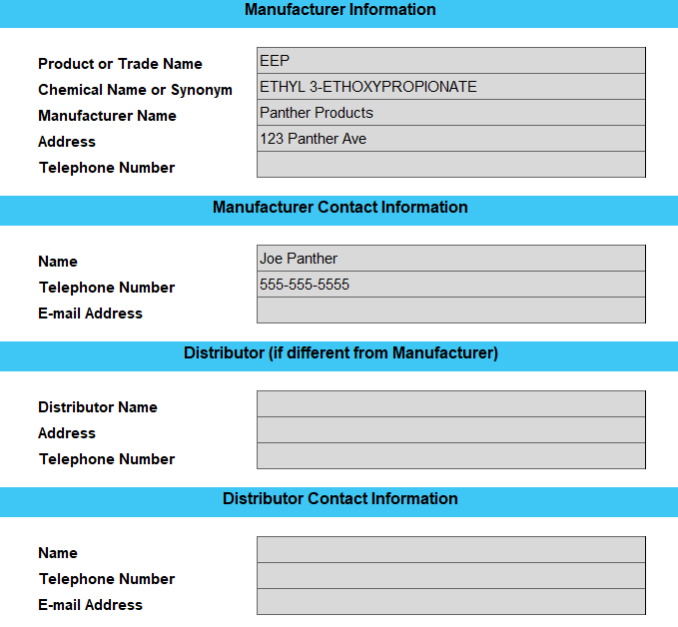
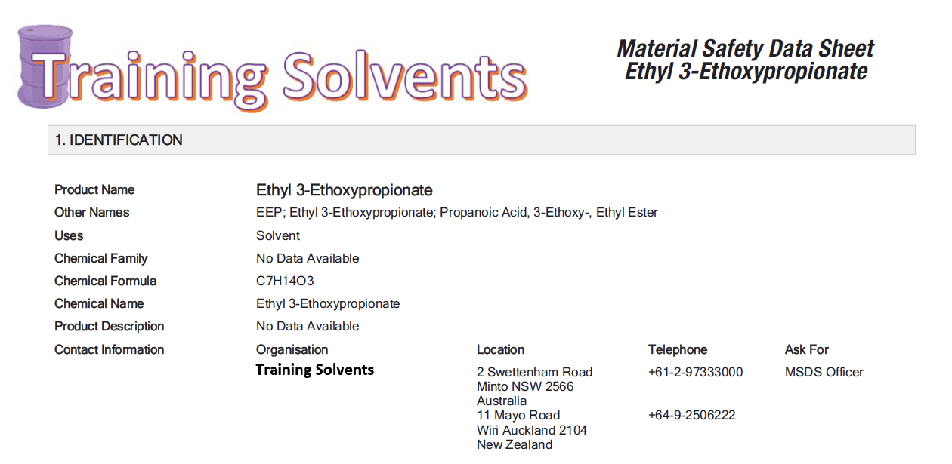
Common Errors
Back to Outline
Missing distributor information.
PPG will review the vendor name on all documents. If distributor documents are provided, the distributor must be listed on Tab A of the RMIR.
Distributor information should be entered here.
Training Solvents
2 Swettenham Road Australia
+61-2-97333000
John Doe
jdoe@trainingsolvents.com

Slide 29
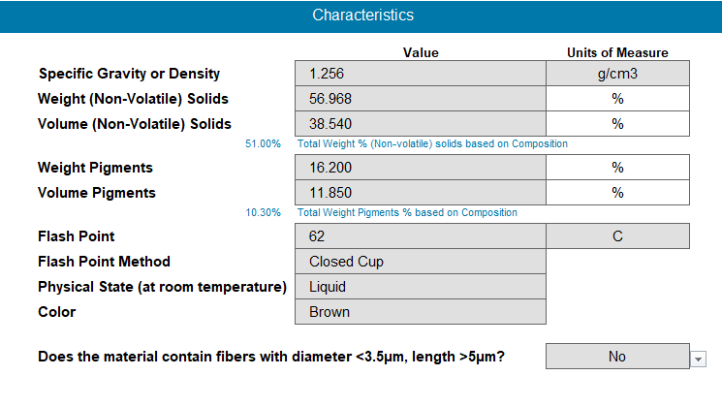

Common Errors
Back to Outline
Inconsistent physical properties. The RMIR will calculate Weight Solids and Weight Pigments based upon the information entered on Tab C - Composition.
After completing Tab C – Composition, review the values entered on Tab B to ensure they agree with the calculated values.

Slide 30
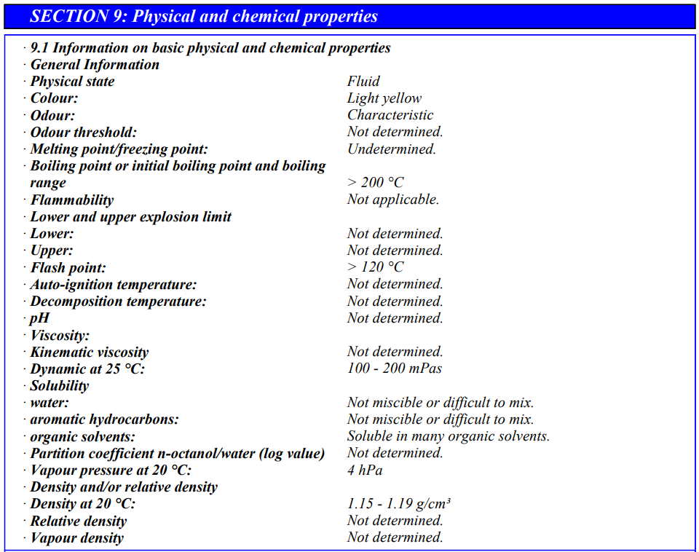
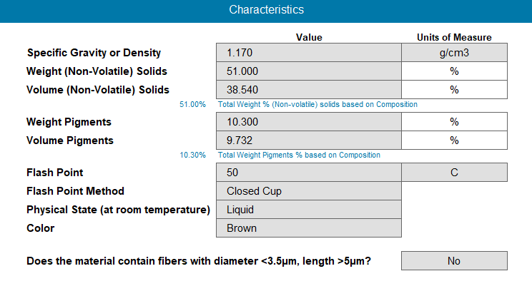
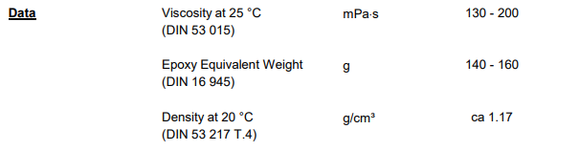
Common Errors
Back to Outline
Inconsistent physical properties.
PPG will verify all values on Tab B with the supporting documents provided.

Slide 31
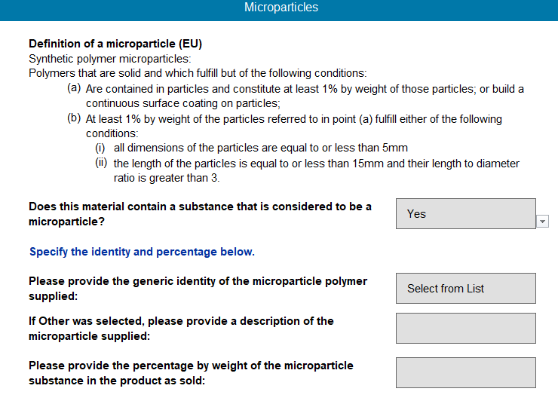
Common Errors
Back to Outline
If Yes is selected, the additional questions must be answered as well.
Incomplete product information. Some sections require additional information when a Yes answer is given.
Applicable sections:
Nanotechnology (Tab B)
Microparticles (Tab B)
Biocides (Tab D)
Food Contact (Tab D)
Alkydes
5%

Slide 32
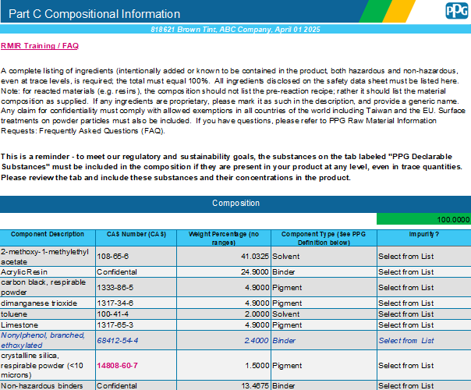
Common Errors
Back to Outline
Invalid composition information. PPG will review for accuracy of all CAS numbers provided.
1333-86-5 is not a valid CAS#. The correct CAS for this substance is 1333-86-4.
100-41-4 is a valid CAS# but is not correct for Toluene.

Slide 33
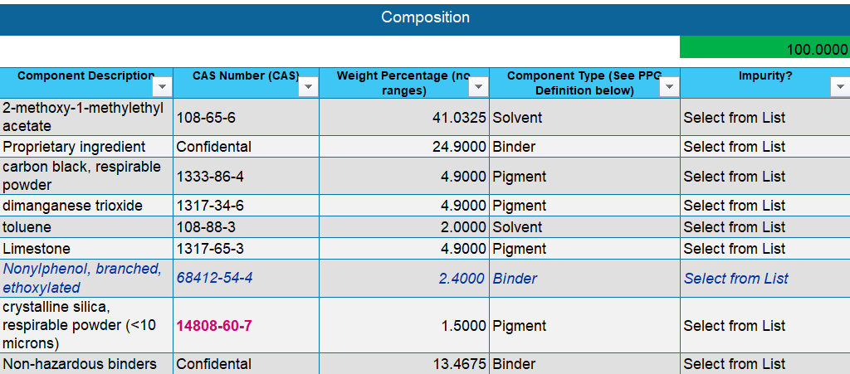
Common Errors
Back to Outline
Insufficient confidential component information provided.
PPG must request a hazard review of proprietary substances by an external evaluator which requires a general idea of what the substance is.
Examples of
acceptable descriptions:
Acrylic resin
Acrylate polymer
Polyester resin
Non-hazardous solvent

Slide 34
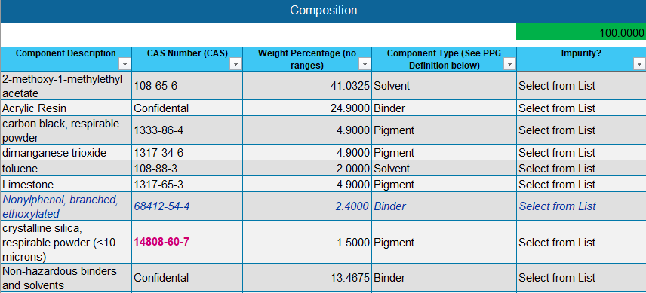
Common Errors
Back to Outline
Combined confidential component(s).
Proprietary components with different physical states should not be lumped together.

Slide 35
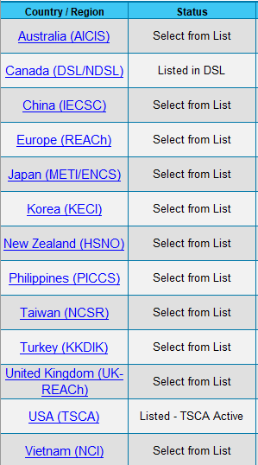
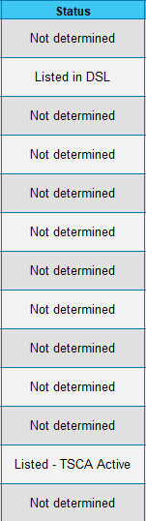
Common Errors
Back to Outline
Incomplete chemical inventory information.
If any chemical inventory region is unknown, select Not Determined rather than leaving the section incomplete. This will avoid unnecessary questioning from PPG who may assume the section was forgotten.

Slide 36
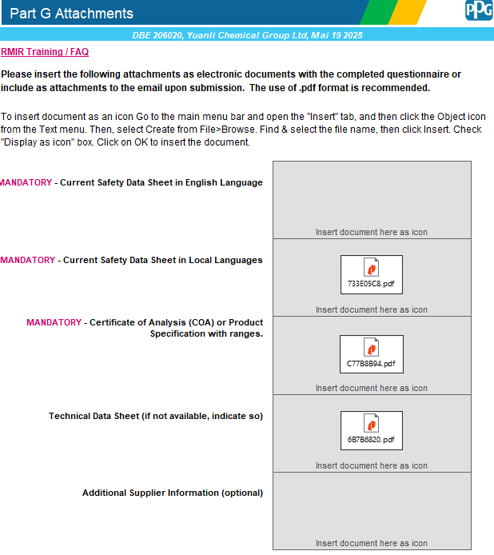
Common Errors
Back to Outline
Mandatory document not provided.
PPG cannot complete the product review without the mandatory documents.

Slide 37
Helpful Links
Back to Outline
Raw Material Introduction Reference Site

